Slide 1


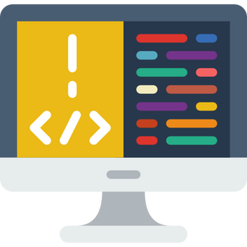
Session 1
Introduction in programming & scratch

Slide 2
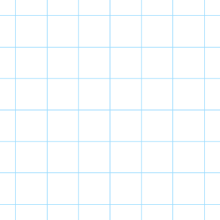

Table Of Content
01
what is programming
02
what is programming language
03
visual programming vs text programming
04
Events
05
write the first code on scratch

Slide 3
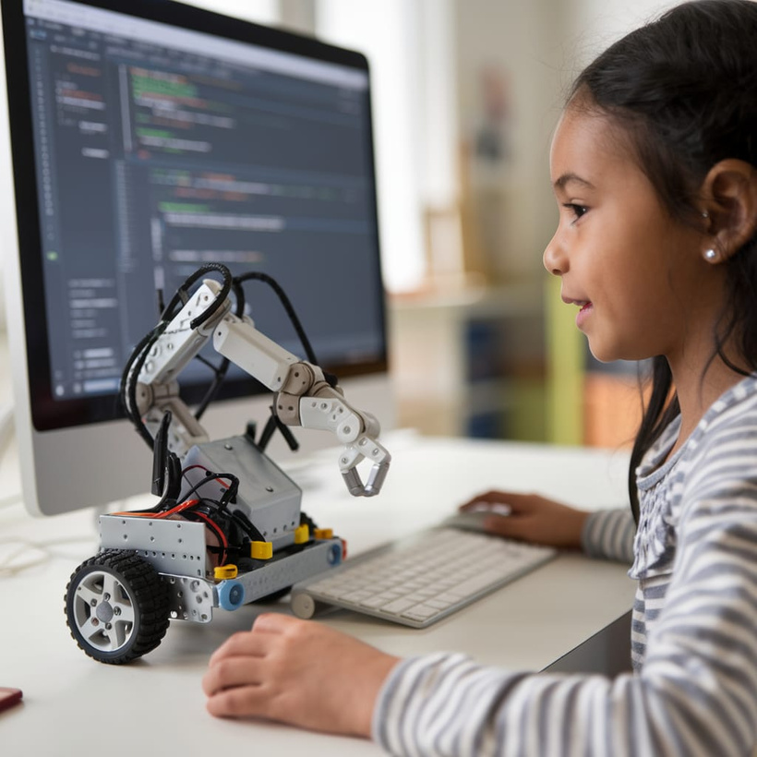
What is programming?
the process of giving instructions
to a computer or other electronic devices to make them do specific tasks.

Slide 4
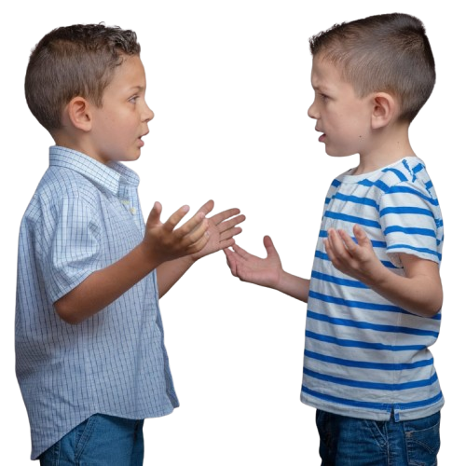
What is programming language?
إسمك ايه؟
؟؟؟؟؟

Slide 5

what is programming language?
a special language that humans use to communicate with computers. Just like we use languages like English or Arabic to communicate with each other.

Slide 6
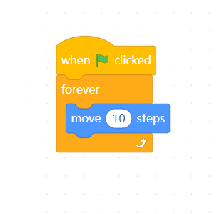
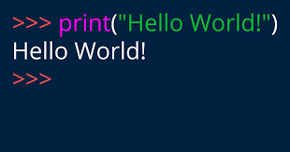
Visual Programming VS Text_Based Programming

Slide 7

Which Software Tool will we use To Create Our Games?

Slide 8


Slide 9
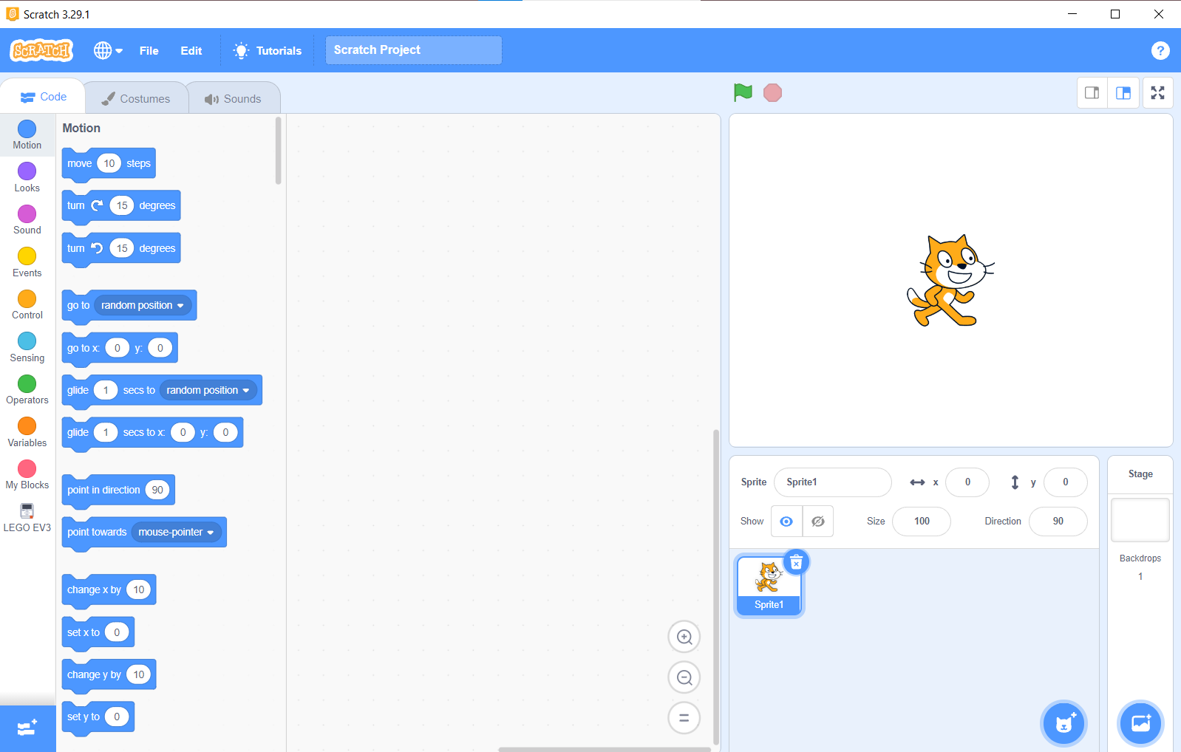
Stage

Slide 10
Maximum & Minimaze

Slide 11
Sprite pane

Slide 12
Sprite Name

Slide 13
Space 2D

Slide 14
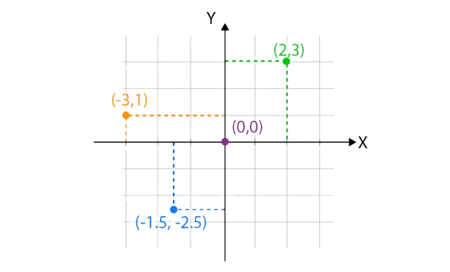
Space 2D

Slide 15
Rotation

Slide 16
Sprite size

Slide 17
visibility

Slide 18
choose sprite

Slide 19
choose background

Slide 20
Tool box

Slide 21
Tool box

Slide 22
Extensions

Slide 23
Scripting Area

Slide 24

Let’s try to Write our first code
Together!

Slide 25
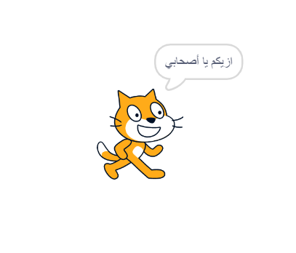
we need the sprite to say hello

Slide 26
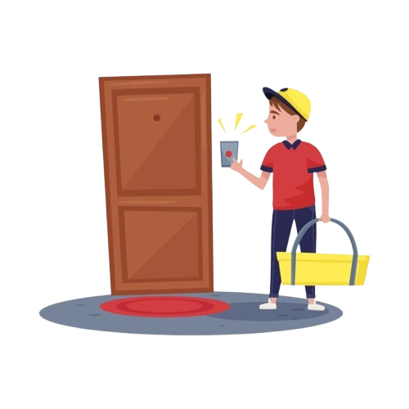
Events
something that happens, and the computer reacts to it by running a specific set of instructions.

Slide 27
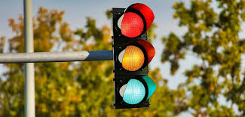
Events

Slide 28
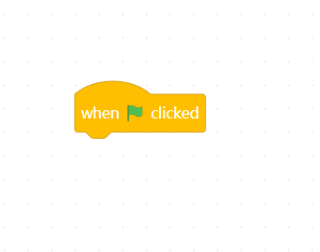
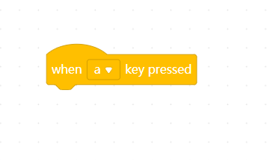
Events in programming
Click Events
Key Press Events

Slide 29
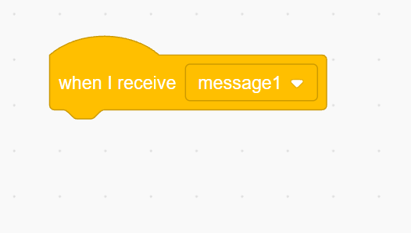
Events in programming

Slide 30
Events in programming

Slide 31
Algorthim
a set of step-by-step instructions that can be followed to solve a problem or complete a task.

Slide 32
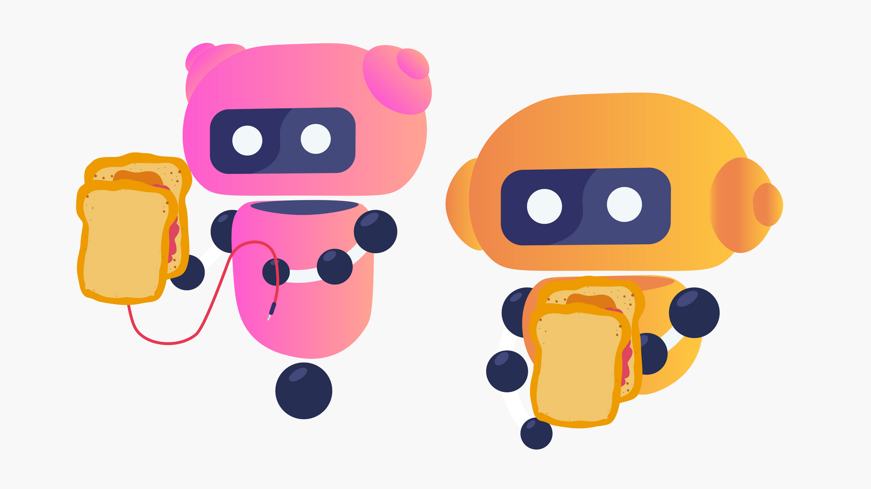
make a peanut butter and jelly sandwich

Slide 33
Algorthim
  Put the bread on a plate.
  Spread peanut butter onto the bread.
  Spread jelly onto the bread.
  Make a sandwich.
  Take a bite!

Slide 34
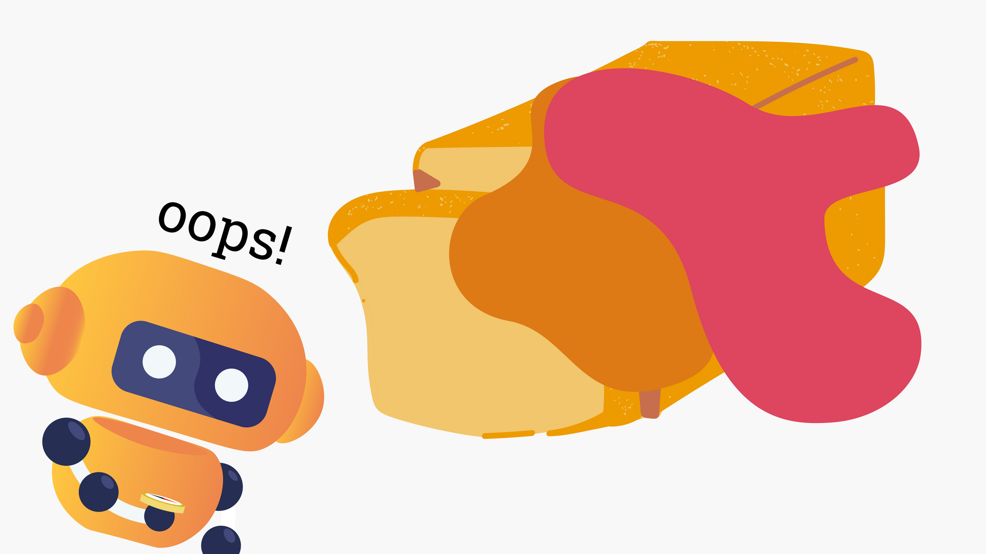
Output

Slide 35
Algorthim
  Put two pieces of bread on a plate.
  Use a knife to spread peanut butter onto one piece of bread.
  Use a knife to spread jelly onto the other piece of bread.
  Put the pieces of bread together to make a sandwich.
  Take a bite!

Slide 36
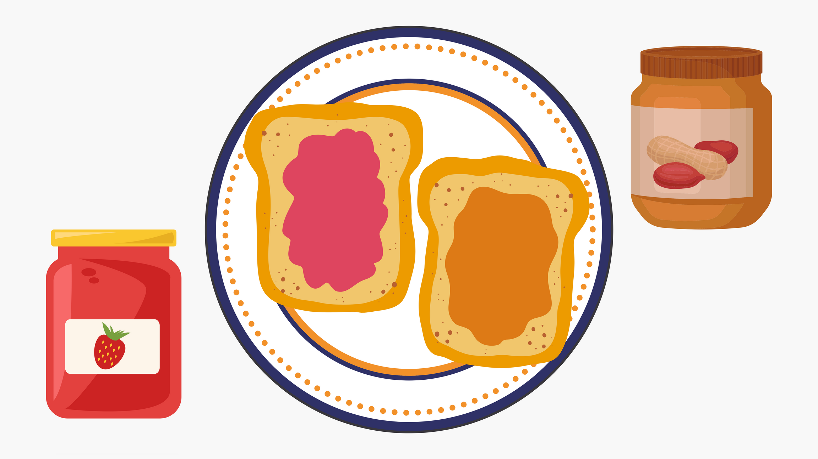
Output

Slide 37


Algorthim

Slide 38
Steps to write code
Planning
Think about what you want your algorithm to do
writing
Write out each step (in code!)
Testing&Debugging
Test your code

Slide 39
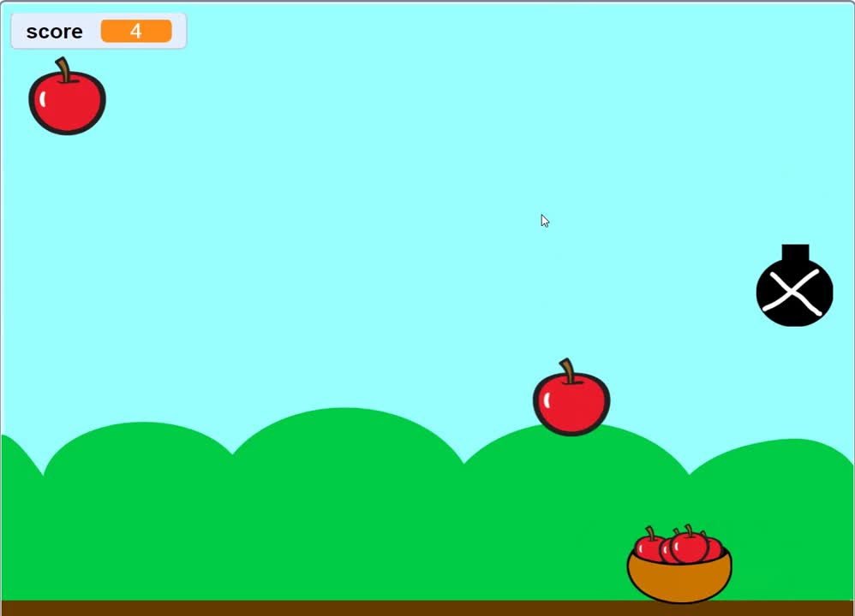
Catching Game

Slide 40
Homework
  introduce yourself by any sprite in scratch
  search on variables

Slide 41

See you Next session

